Slide 1
Spotify Discovered
David Holowitz, Kevin Ng, Stephen Siegel, Vladlen Suris

Slide 2
Overview
Data sources are from the Spotipy library which parses and pulls data from Spotify
Our program compares music attributes between our groups Spotify Recent 50 Songs in order to learn user preferences
Our program can accurately figure out who listened to a given song out of our group based on learned attributes

Slide 3
Data
Work Flow
Focused Attributes
Parsed Spotify for 50 recently played songs per user with their respective attributes
Dataset equaled to 200 songs
Created a second set of data for testing which featured our combined playlists
Each song has a set of attributes (extensive list) and we decided to focus on:
Danceability
Energy
Mode
Speechiness
Acousticness
Instrumentalness
Liveness
Valence

Slide 4
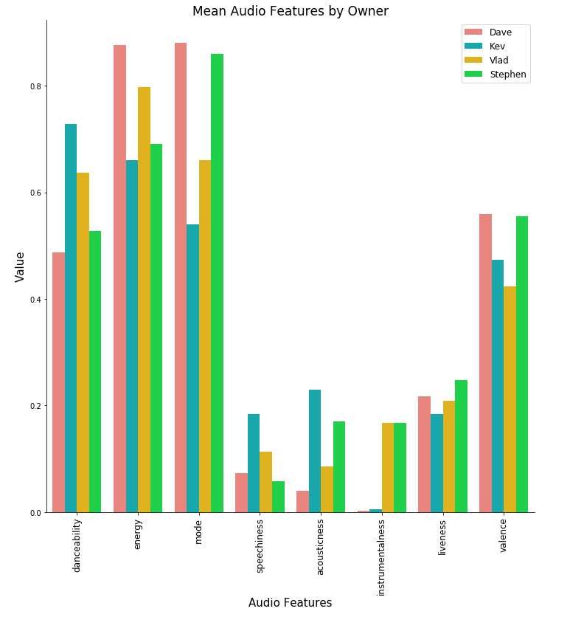
Main Attributes By User

Slide 5
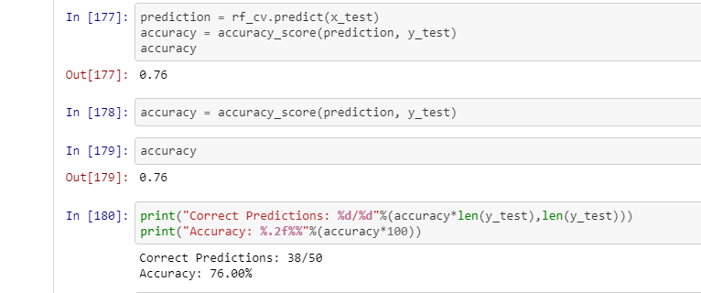
Machine Learning
Trained on our whole group’s data (recently played songs) to create user attributes
User attributes determines song match

